Slide 1

Not Guilty - Empowering Communities to Prevent Abuse and Bullying

Slide 2
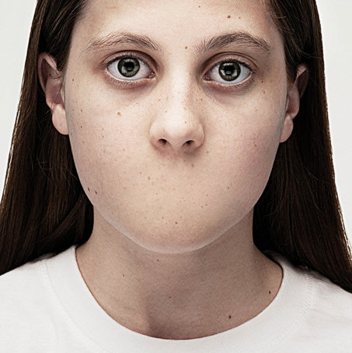
1 in 9 Girls
1 in 53 Boys
Under 18 Experience Sexual Abuse or Assault
82% of All Victims under 18 are female!
Source: Department of Justice, Office of Justice Programs, Bureau of Justice Statistics,
Sexual Assault of Young Children as Reported to Law Enforcement (2000)

Slide 3
1 in 4 Girls
1 in 6 Boys
Under 18 Experience Sexual Abuse or Assault
Source: UN 2013

Slide 4

Only 10% Of Cases Are Reported Due
To Cultural Sensitivity
LET’S KEEP THIS
OUR LITTLE SECRET
Source: National Center for Social and Criminological Research, 2006

Slide 5
The Problem
53% blamed the woman for ‘bringing it on’.
(Dr. Heba AbdelAziz PhD. )

Slide 6
The Problem
Worldwide, approximately 40 million children below the age of 15 are subjected to child abuse each year. (World Health Organization (WHO) 2001)

Slide 7
My Belief System
Prevention Is Better Than Cure
It Is Never The Victim’s Fault
It Is Time To Raise Up A Generation Who Says “NO” To Abuse and Assault

Slide 8
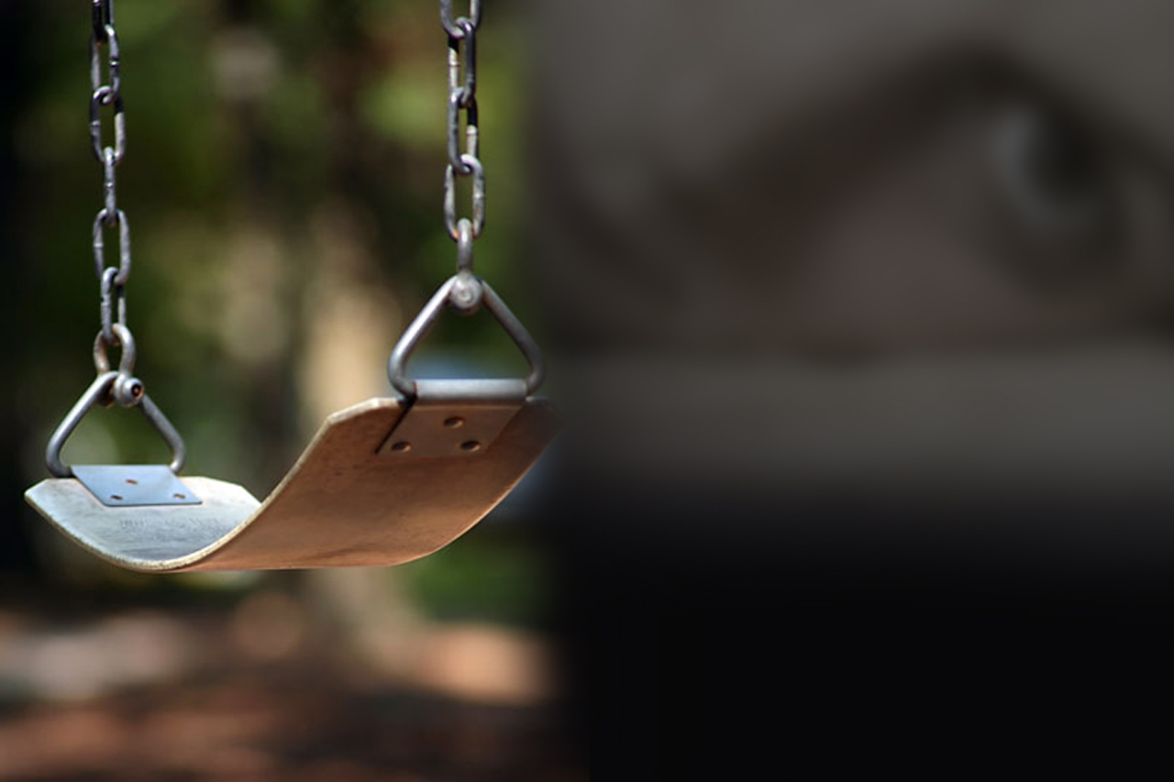
My vision is to bombard society with anti sexual abuse material, using a three pronged approach: train students, train the parents, train the teachers using a method I developed called SKIT

Slide 9

The social stigma surrounding such topics prevents children from communicating the abuse they experience.
Parents play a huge role in prevention. Early identification signs and behavioral changes can help children understand and learn.

Slide 10
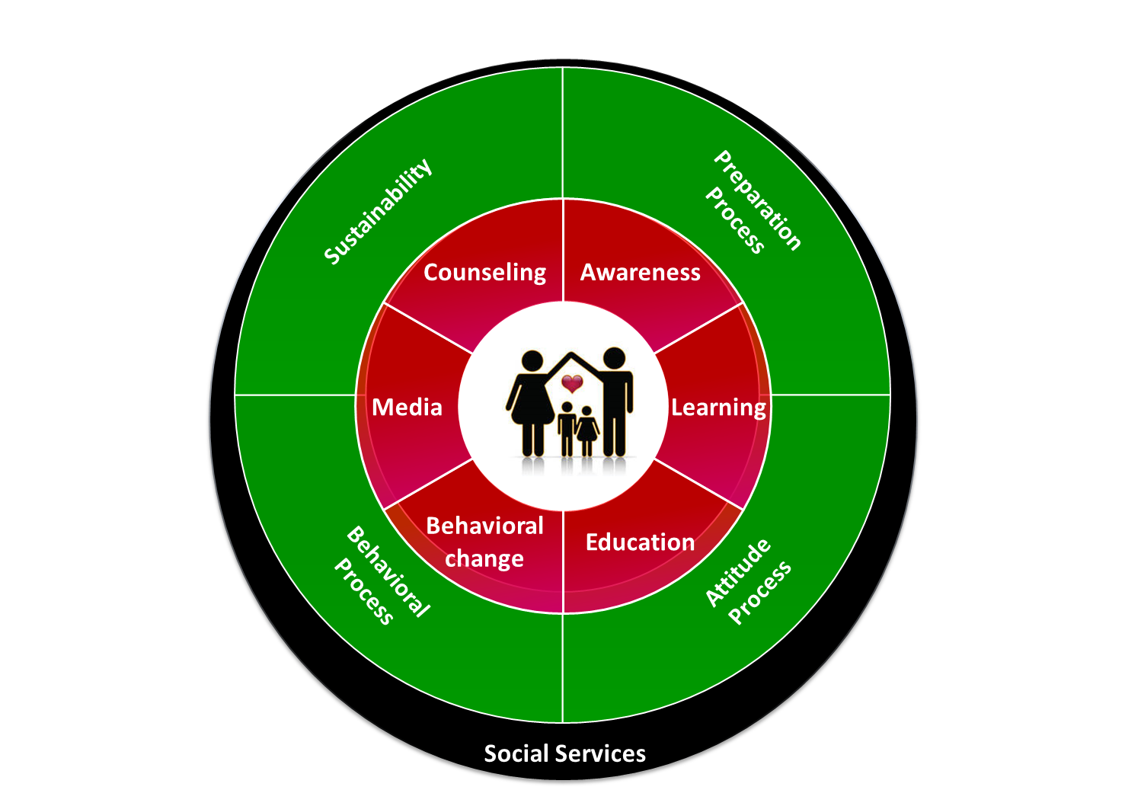

This is the place to describe what your Solution is all about, and what makes it work.
Think about your Solution in terms of
Ideas
Processes
Skills
Organizational components
Values and principles
Technologies
Which aspects of your Solution are non-negotiable, which ones are supporting the core elements, and which ones are only peripheral or nice to have? Focus only on the non-negotiables here.
Keep it really simple. One page only. Font size at least 18.
The Solution

Slide 11
The Effects of Sexual Assault
About 4 times more likely to develop symptoms of drug abuse
About 4 times more likely to develop PTSD as an adult
About 3 times more likely to experience a major depressive episode as adults
Source: H.M Zinzow, H.S. Resnick, J.L. McCauley, A.B. Amstadter, K.J. Ruggiero, & D.G. Kilpatrick, Prevalence and risk of psychiatric disorders as a function of variant rape histories: results from a national survey of women. Social psychiatry and psychiatric epidemiology, 47(6), 893-902 (2012).

Slide 12

What you see is just the tip of the iceberg
Perfectionism
Anxiety
Emotional Withdrawal
Sexual Difficulties
Control
Depression
Anger
Addictions
Seductive Behavior
Fear
Betrayal
Guilt
Manipulation
Abuse
Shame
Deception
Low Self-Esteem
Self-Loathing
Notes:
But this is not just any book. This book is a tool for . . .

Slide 13
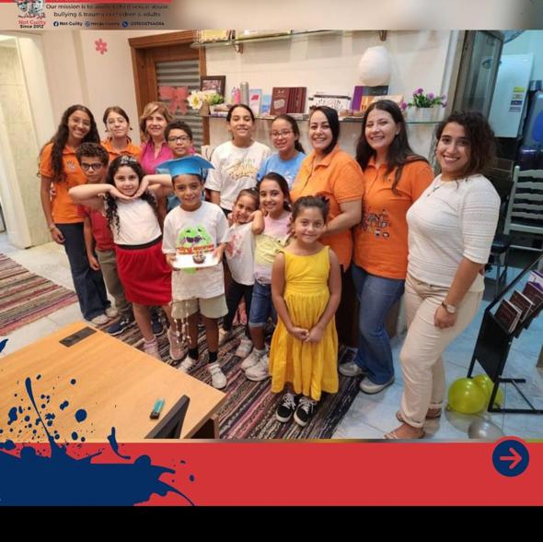
Service Offerings
Core Services:
  Sexual abuse prevention workshops.
  Anti-bullying education programs.
  Community engagement and support initiatives.
Specialized Focus: Children, youth and women rehabilitation and Support Services, providing workshops that help individuals build resilience and understand healthy relationships.

Slide 14
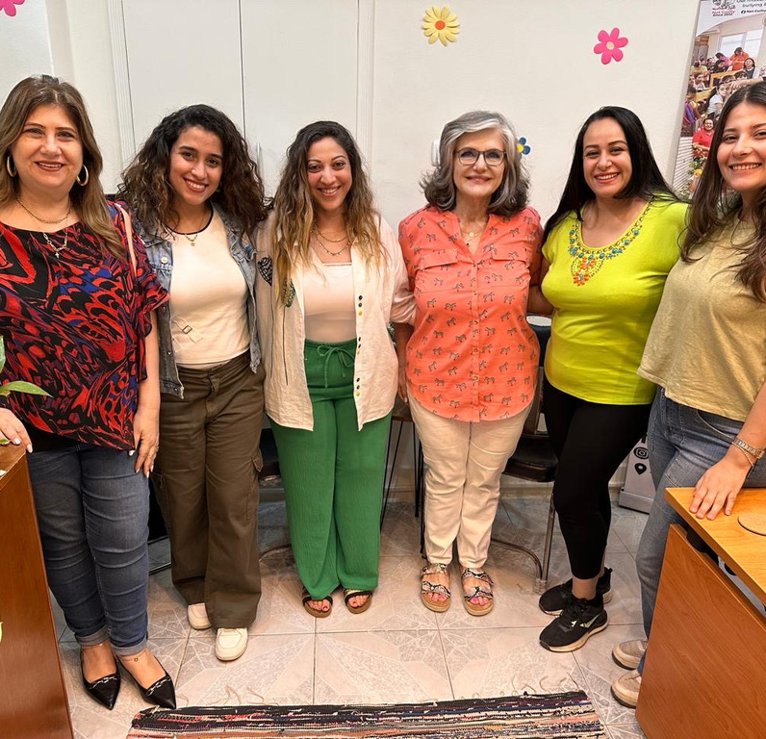
Social Impact
Impact Goals: Decrease the incidence of sexual abuse and bullying in communities.
  Create safer environments in schools and neighborhoods.
  Increase reporting and support for victims.
Target Audience: Youth, educators, parents, community leaders, and organizations involved in youth rehabilitation.
Outcomes: Empowered individuals who are informed, vigilant, and dedicated to creating abuse-free communities.

Slide 15
Social Impact since 2012
9000 students
2000 nursery kids
4000 teachers
1500 parents
400 refugees
60 government schools
20 private schools
800 social workers

Slide 16
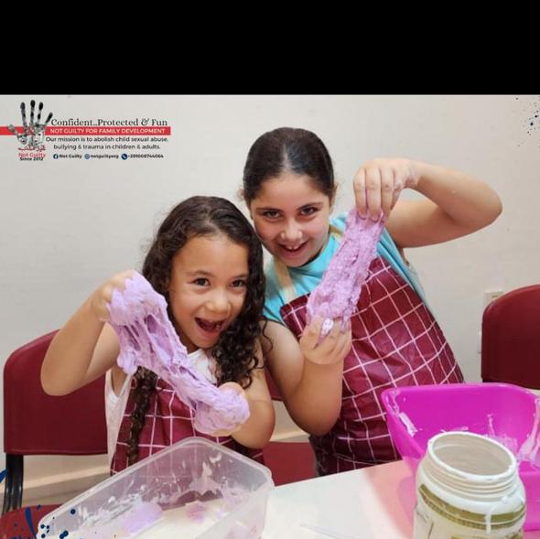
Competitive Landscape
Current Landscape: Mix of nonprofits, government initiatives, and educational organizations focused on raising awareness.
  Many existing programs lack depth, cultural sensitivity, and hands-on engagement.
Our Differentiation: Customized, interactive workshops tailored to diverse cultural contexts.
  Comprehensive focus on youth, educators, parents, and community leaders.
  Specially trained facilitators who handle sensitive topics with care.

Slide 17
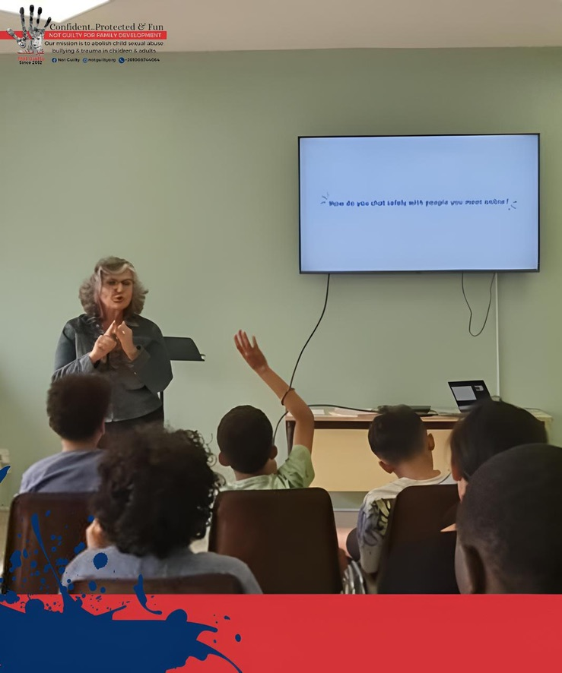
Competitive Advantage
Unique Approach:
  Real-life scenarios, role-playing, and open dialogue to create impactful learning experiences.
  Cultural adaptability ensuring relevance in varied contexts like Abu Dhabi.
Strategic Partnerships:
  Strong local partnerships to enhance reach and sustainability.
  Collaboration with schools, community centers, and rehabilitation facilities.
Leadership Position:
  Positioned as a leading innovator in the field of abuse prevention and anti-bullying education.

Slide 18
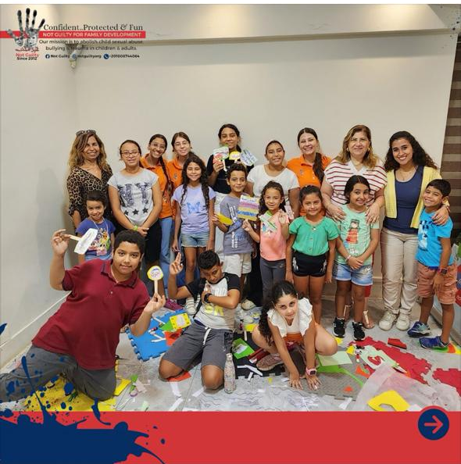
Implementation Strategy
Phase 1: Pilot programs in select schools and community centers.
Phase 2: Scale across Abu Dhabi through strategic partnerships and outreach.
Sustainability: Ongoing monitoring, evaluation, and adaptation to ensure long-term impact.

Slide 19
Contact Information
Thank you for your interest in Not Guilty and our mission to prevent abuse and bullying.
Contact Information:
contact@gheirmozneb.org

